Slide 1
A framework
for
Information systems Architecture:

Slide 2
A framework for Information systems Architecture:
An information system architecture serves as a higher level framework for understanding different views of the fundamental building blocks of an information system.
IS architecture provides a foundation for organizing the various components for any developing information system.
The three business goal-oriented perspectives or views of an information system are the goal to improve business knowledge, business process and business communications.

Slide 3
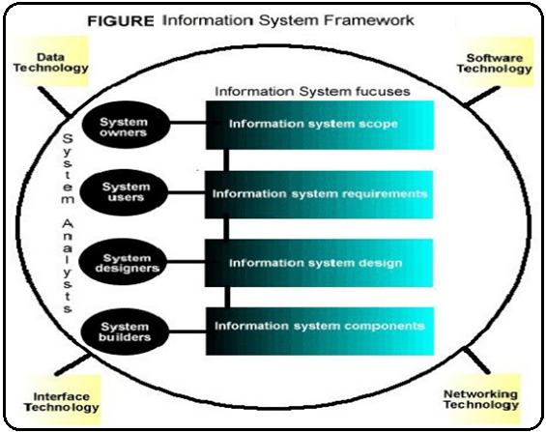

Slide 4
Information system Perspectives /Building blocks
Knowledge Building Blocks
Process Building Blocks
Communications Building Blocks

Slide 5
Knowledge Building Blocks
Improving business knowledge is a fundamental goal of an information system.
Business knowledge is derived from data and information.
Data is refined to produce information that results as Knowledge.
Knowledge is that strength which enables a company to achieve its mission or vision.

Slide 6
Process Building Blocks
Improving the business and service processes is the another fundamental goal of an information system.
Process represents the work in a system.
Processes deliver the desired functionality of an information system.
People may perform the some processes and computers/machines perform others.

Slide 7
Communications Building Blocks
It is the final building block of information system.
A common goal of most organizations is to improve the business communications and collaboration between employees and other constituents.
The communication should promote team work and coordination of activities.
The communication should interface effectively and efficiently with other business information systems.

Slide 8
Network Technologies and IS Building Blocks:

Slide 9
Network Technologies and IS Building Blocks:
Network is the system of interconnected computers and devices to share data, information and resources with each other.
Today’s information systems are built on networks.
Network technology allows properly designed information system to separate the Knowledge, Process and Communication building blocks.
It forces these building blocks to communicate across the network.

Slide 10
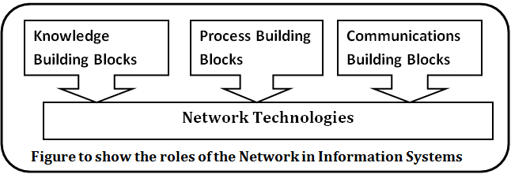

Slide 11
Network technology can be database technology, software technology, Interface technology.
This technology supports to perform operations easily and fastly.
Network technology tends to use the information system in very minimal cost.
Network technology supports to use information system world wide without any extra labor and cost.
Remote accessing system also can be used for the use and process of information system.

Slide 12
QUESTION COLLECTION
Why do we need to identify the information system architecture?
How are the business perspectives and technology perspectives of an information system related?
What are the three business goal-oriented perspectives of an information system?
In any building block of an information system ,the views of four groups of stakeholders need to be taken into account during the development of the system. What are these four stakeholder group?

